Slide 1
METAPHOR From science to psychotherapy
Niklas Törneke

Slide 2
The structure of this talk
What is metaphor?
Metaphor in modern linguistics
An relational frame theory analysis of metaphor
Clinical research
Clinical guidelines for using metaphor

Slide 3
Background and general points on metaphor in psychotherapy
Almost everybody agrees about it’s importance
Limited research, especially in the CBT tradition
Some research from psychodynamic and emotion-processing assumptions
Lots of research in linguistics and cognitive science about metaphor in general

Slide 4
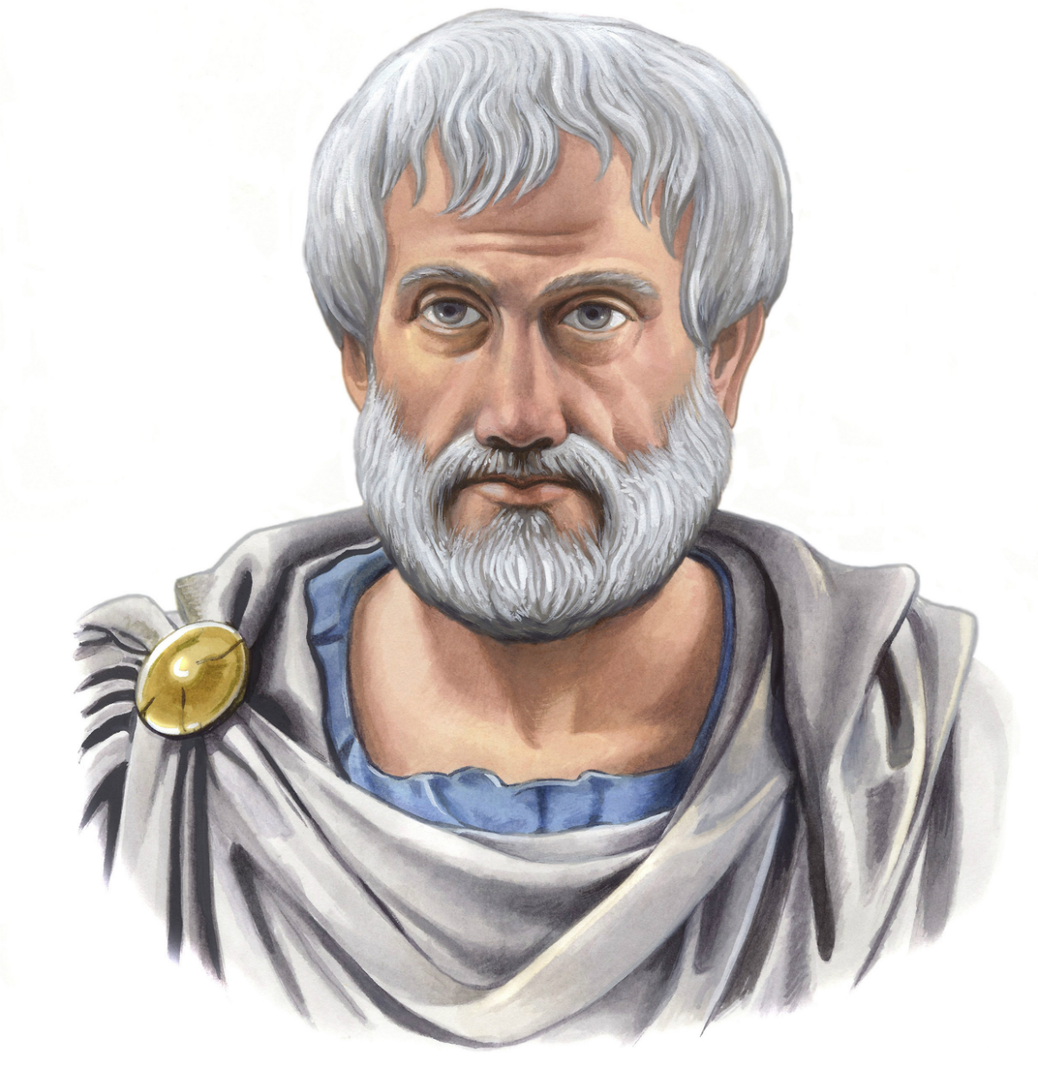
Definition
Aristotle (384-322 BC), in Poetics:
”Metaphor consists in giving the thing a name that belongs to something else”

Slide 5
Basic terminology
”Giving the thing (target) a name that belongs to something else (source)”
Source (vehicle, base): Better known, more concrete
Target (topic): Less known, more abstract
Notes:
She is a rising star
Peter and Louise are like night and day
The bus metaphor
Your mind is a talking machine
We'll come back using RFT

Slide 6
Traditional view
Literal language is basic
Metaphorical talk is ”an extra”
Traditional use: poetry and rhetorical talk

Slide 7
Modern linguistics

Slide 8
The Lakoff-Johnson revolution
Metaphors we live by (1980)
Metaphors are not ”an extra”, they are at the very root of language and cognition
”Conceptual” metaphors, inbedded in all cognition and language
A bit like cognitive structures, cognitive schema

Slide 9
Conceptual metaphors
Argument is war (“Your position is totally indefensible”; “His argument was easy to shoot down”; “She kept attacking my views”)
Life is a game (“The odds are against me”; “If I play my cards right…”; “She drew the short straw”)
Ideas are objects (“Bring that to our next meeting”; “Will you please drop that?”)
Ideas are food (“I find that hard to swallow”; “It was something to get my teeth into”)
Ideas are goods (“You’ll have to try to sell him that”; “Your idea is completely worthless”)
Theories are buildings (“It was a theory built on sand”; “That’s where your theory falls to the ground”)
Anger is pressure in a container (“He was bursting with anger”; “I exploded with anger”; “She could not contain her rage”)
The mind is a machine (“He’s got a screw loose”; “I feel totally rusty”; “That got the old cogs working”)
Influence is a physical force (“I couldn’t resist the pressure”; “That really made an impact on me”)

Slide 10
Recent linguistic critique of the theory of conceptual metaphors
Using a metaphor is always an act in context. Focusing on conceptual metaphors (rather than actual metaphor use) has the risk of missing this obvious fact. We need to analyze metaphors in the context in which they are used.
Cornelia Müller (2008) Metaphors dead and alive, sleeping and waking. A dynamic view
Steen, G. J. (2011) The contemporary theory of metaphor – now new and improved. Review of Cognitive Linguistics, 9:1, 26-64

Slide 11
The town of Addison
Lera Boroditsky
Crime is like a beast, versus crime is like a virus
Solutions of law enforcement (police force, penalties), versus investigating the underlying cause of the problem (economy, education)
Thibodeau, P. H. & Boroditsky, L. (2013). Natural language metaphors covertly influence reasoning. PLoS ONE 8(1): e52961. doi:10.1371/journal.pone.005296

Slide 12
An RFT analysis of metaphor

Slide 13
Relational frame theory: the behavior of relating is at the root of language and cognition
Relating phenomena (stimuli, events, objects) under the control of arbitrary contextual cues
Metaphor: relating relations

Slide 14
“Peter and Louise are like night and day”
Peter Night
Same as (coordination)
Dissimilarity
Dissimilarity
Louise Day
Target Source

Slide 15
“Peter and Louise are like two peas in a pod”
Peter Pea
Same as (coordination)
Similarity
Similarity
Louise Pea
Target Source

Slide 16
“Peter and Louise are like cats and dogs”
Peter Cats
Same as (coordination)
Relation
of conflict
Relation
of conflict
Louise Dogs
Target Source

Slide 17
“My thinking is a machine”
My thoughts Machine
Same as (coordination)
Relation of distance
Relation of distance
Me Me
Target Source

Slide 18
Clinical research

Slide 19
Conclusions from clinical research
The amount of metaphors used does not seem to be a significant aspect of successful therapeutic dialogue
If a metaphor is generated by the therapist or patient does not seem to predict if the metaphor will be helpful or not.
The degree of collaboration between therapist and patient in the use of a particular metaphor seems to correlate with successful therapy.
Problems of research

Slide 20
Research on metaphor use: the way forward
”One way to begin thinking about what a contextual approach would entail is to start not with a focus on metaphors, per se, but rather on events of clinical interest …” (Linda McMullen 2008. Putting it in context: Metaphor and psychotherapy. In R. W. Gibbs (red.), The Cambridge handbook of metaphor and thought (p. 397–411). p. 408).)

Slide 21
Clinical events of interest: Psychological flexibility

Slide 22
What is psychological flexibility?
Psychological flexibility is a behavioral repertoire and it’s essence is about how we interact with our own behavior (how we respond to our own responding)
Why important? Because once humans can relate under the control of arbitrary contextual cues (symbolic generalization) our own responding will be an important part of the context influencing the following behavior of the same individual.
RFT for clinical practice: Three core strategies in understanding and treating human suffering. Törneke, Luciano, Barnes-Holmes & Bond (2016). In Zettle, Hayes, Barnes-Holmes & Biglan (ed.), Wiley handbook of contextual behavioral science (p. 254–272)

Slide 23
How to train psychological flexibility
Help the patient discern the relationship between what he does and the problematic consequences he experiences.
Help the patient discern his own responding (including thoughts, emotions and physical sensations) by establishing observational distance to them as they emerge.
Help the patient use this skill to clarify what is important in his life and what would be concrete steps in that direction.

Slide 24
How to use metaphor in therapy as part of training psychological flexibility
Notes:
Stress: this is not metaphor therapy

Slide 25
Different ways of using metaphors in treatment
Introduce metaphors guided by the three strategies for training psychological flexibility
Catch metaphors used by the client, guided by the same three principles
Co-create and develop metaphors together with the client, guided by the same three principles

Slide 26
“You simply parked”
To refrain from what
you really want to do
To enter a parking place
Causal relation
Same as (coordination)
Causal relation
No further progress
The travel is brought to a halt,
no further progress
Target Source
Notes:
Once again: the metaphor can only be analyzed in the context of it's use. Could "mean" many different things
In this context: part of ABC analysis, the link between B and C
The therapist is guided by the first principle for training psychological flexibility.
Watches for signs of co-creation
Back to earlier slide

Slide 27
RFT for Clinical Use: The Example of Metaphor.
Foody, Barnes-Holmes, Barnes-Holmes, Törneke, Luciano, Stewart & McEnteggart 2014. Journal of Contextual Behavioral Science, 3, 305–313.
RFT for Clinical Practice: Three Core Strategies in Understanding and Treating Human Suffering.
Törneke, Luciano, Barnes-Holmes & Bond 2016. In Zettle, Hayes, Barnes-Holmes & Biglan (ed.), Wiley handbook of contextual behavioral science p. 254–272
Metaphor. A Practical Introduction. Kövecses, Z. 2010
Metaphor in Practice: A Professional’s Guide to Using the Science of Language in Psychotherapy. Törneke, 2017.

Slide 28
Available August 2017
Notes:
Remind of workshop

Slide 29
Contact
niklas.torneke@telia.com

